Slide 1
Moxie Devices

Slide 2
About US
Established & Registered in Year 2012.
A professionally managed company with specialization in design and manufacturing of Electronics circuits ranging from AC-DC Adaptors, LED Drivers to Solar Energy based products like Solar LED lantern/ solar mobile charger.
Working aggressively on new product Specifications to cater requirements in Lighting Industry for In-door & Out-door lighting applications.
Moxie Devices team comes with an approximately 40 man-years of diverse experience in semiconductor & Electronics Industry .
The strength of Moxie devices lies in the understanding the challenges & catering the right solutions with right consultancy to its prospective clients.
Our Vision is to become a trusted partner with all our clients.

Slide 3
Agenda
Energy Aware Survey on Mobile chargers
Adaptor Product Portfolio
Test & Measurement Setup
Comparative Landscape
Selection Criteria for Mobile Charger
Upcoming Design
Complete Product Portfolio

Slide 4
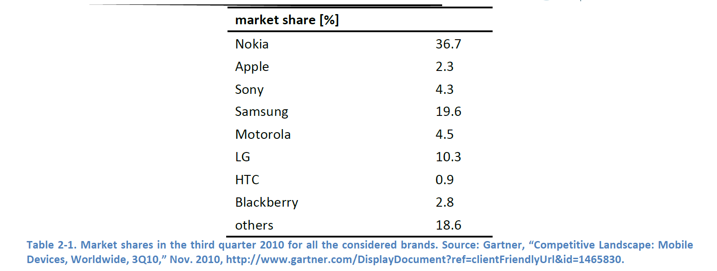
An Energy Aware survey on Mobile phone Charger by Gartner
Market Share

Slide 5
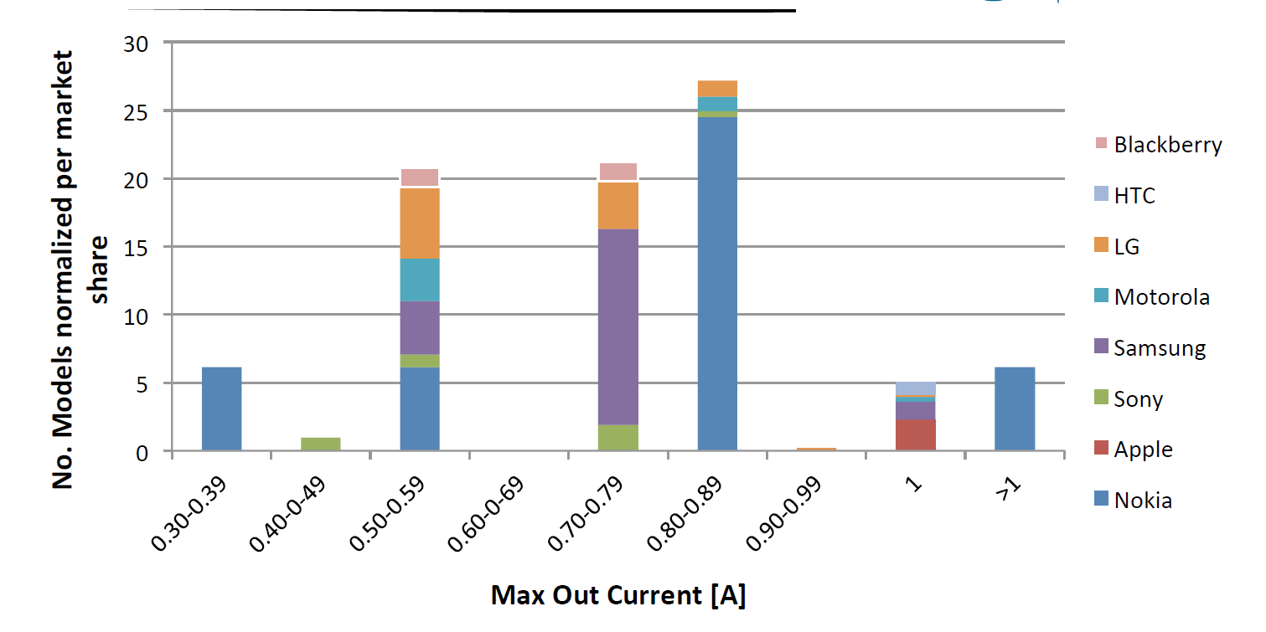
DC-Current Output
Sample no of chargers =117
Notes:
This is to emphasize that maximum output current delivering is of the range form 0.5 to 0.9A

Slide 6
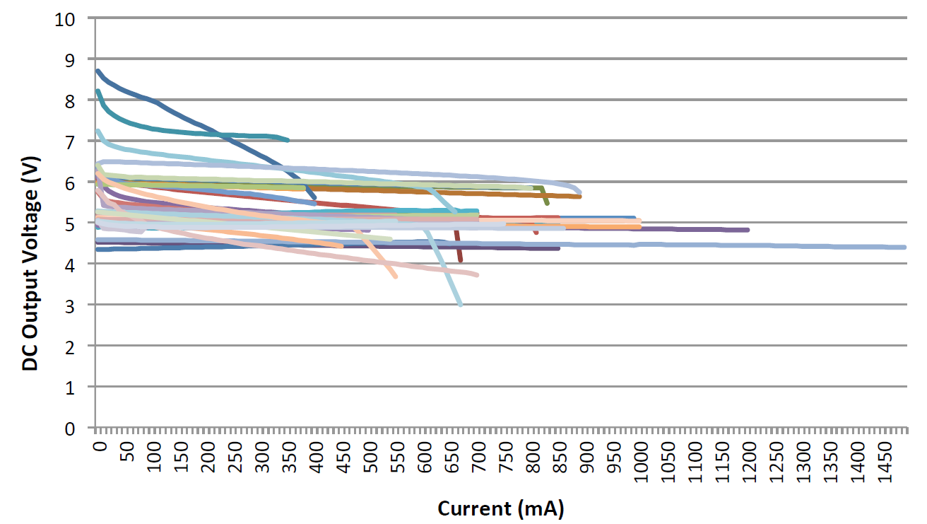
DC output Voltage
Notes:
This is to Emphasize that the O/P voltage cluster is on an average 4.5v to 5.5/6v

Slide 7
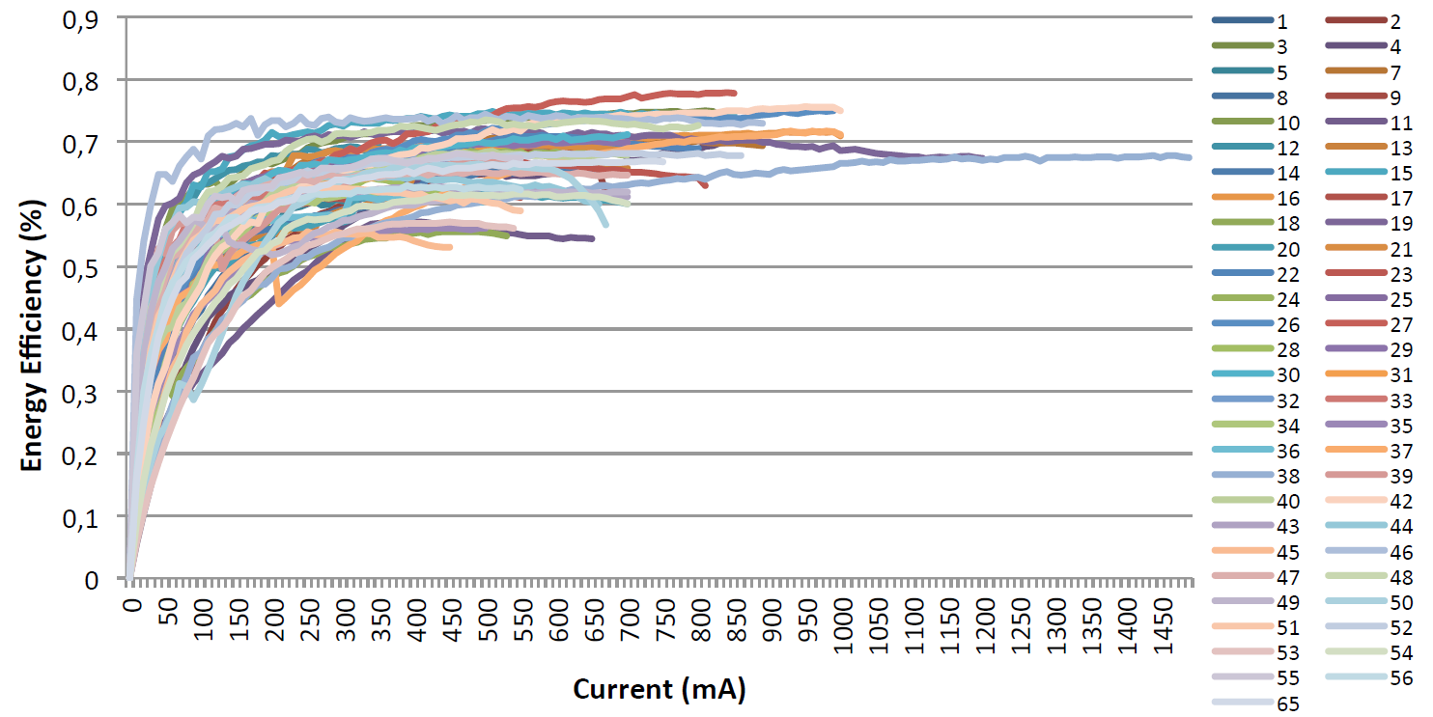
Energy Efficiency
Notes:
Energy Efficiency cluster is around 65-75%

Slide 8
Agenda
Energy Aware Survey on Mobile chargers
Adaptor Product Portfolio
Test & Measurement Setup
Competition Landscape
Selection Criteria for Mobile Charger
Upcoming Design
Complete Product Portfolio

Slide 9
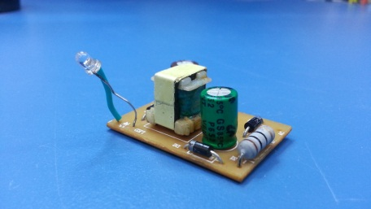
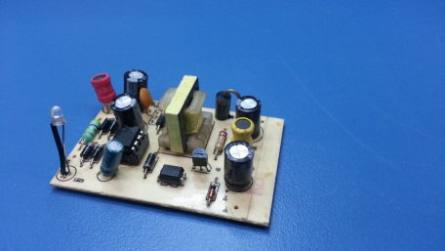
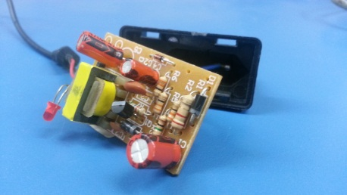
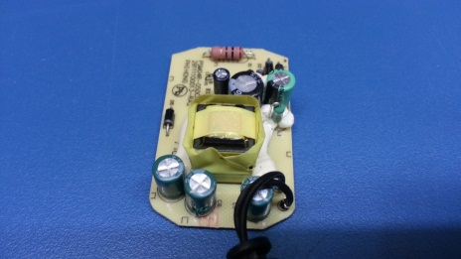
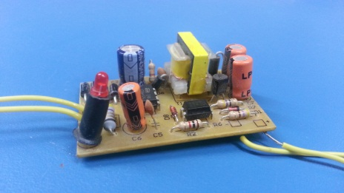
Adaptor Product Portfolio
A-ADL025
A-ADV04-A8
A-ADT015
BB-9680
A-ADV04-B8
*All Images correspond to real physical boards

Slide 10
Agenda
Energy Aware Survey on Mobile chargers
Adaptor Product Portfolio
Test & Measurement Setup
Comparative Landscape
Selection Criteria for Mobile Charger
Upcoming Design
Complete Product Portfolio

Slide 11
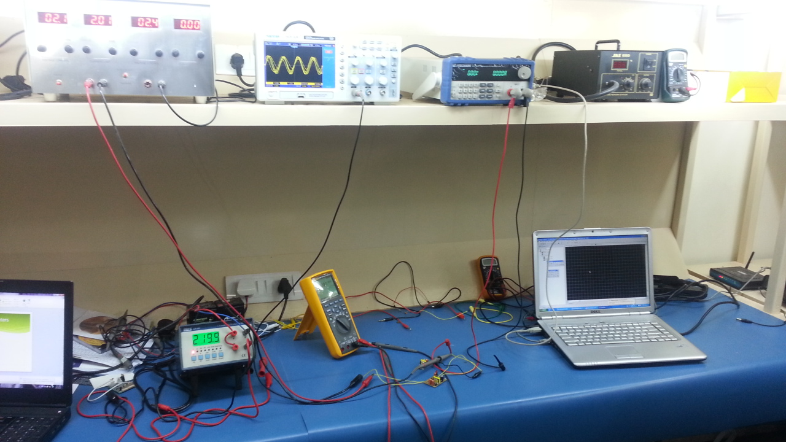
Test-Setup

Slide 12
Key Measurement Parameters
Input | Output | Protection
Efficiency | Rated Current | Overload
Inrush Current | Rated Voltage | Thermal
Leakage Current | Rated Power | Short Circuit
AC Current | Ripple & Noise | Fault detection
 | Line Regulation | Safety Standards
 | Load Regulation

Slide 13
Agenda
Energy Aware Survey on Mobile chargers
Adaptor Product Portfolio
Test & Measurement Setup
Comparative Landscape
Selection Criteria for Mobile Charger
Upcoming Design
Complete Product Portfolio

Slide 14
Comparative Landscape
Model No. | Rated Current | Rated Voltage | Rated Power | Ripple & Noise | Line Regulation | Load Regulation | Efficiency | Inrush Current | Leakage Current | AC Current | Protection Type
A-ADT015 | 0.3 | 5.0 | 1.5 | 0.16 | +/-10% | +/-10% | 0.34 | 3 | 0.004 | 0.025 | NA
A-ADL025 | 0.45 | 5.5 | 2.5 | 0.19 | +/-1% | +/-3% | 0.81 | 6 | 0.001 | 0.002
A-ADV04-A8 | 0.5 | 8.2 | 4 | .408 | +/-1% | +/-3% | 0.7 | 2 | 0.002 | 0.02
A-ADV04-B8 | 0.5 | 8.2 | 4 | .150 | +-1% | +/-3% | 0.75 | 0.6 | 0.004 | 0.05
BB | 0.7 | 5 | 3.5 | .025 | +-1% | +/-0.5% | 0.75 | 3.5 | 0.002 | 0.04

Slide 15
Agenda
Energy Aware Survey on Mobile chargers
Adaptor Product Portfolio
Test & Measurement Setup
Comparative Landscape
Selection Criteria for Mobile Charger
Upcoming Design
Complete Product Portfolio

Slide 16
Cost vs Quality vs power
Power
BB
????
A-ADV04-A8
A-ADV04-B8
Quality (Regulation)
????
A-ADL025
A-ADT015
cost

Slide 17
Agenda
Energy Aware Survey on Mobile chargers
Adaptor Product Portfolio
Test & Measurement Setup
Comparative Landscape
Selection Criteria for Mobile Charger
Upcoming Design
Complete Product Portfolio

Slide 18
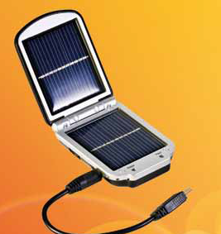
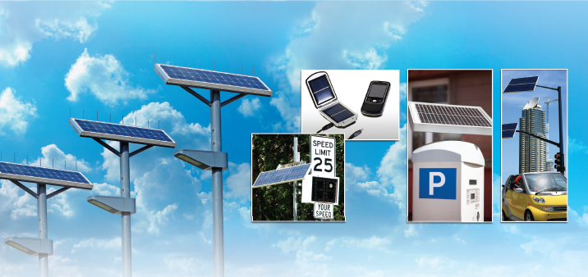
Solar based Solutions

Slide 19
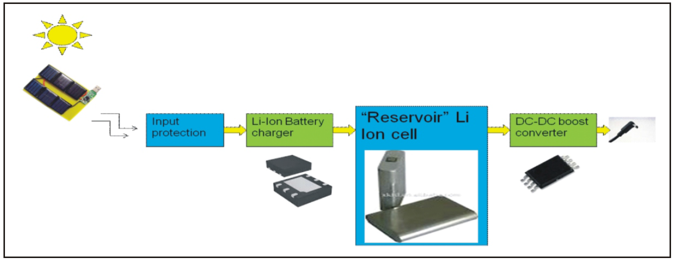
Working Principle

Slide 20
Solar based Mobile Charger
Low power, low voltage
0.3 V up to 5.5 V input operating
2v up to 5.2 V output voltage regulation
1.8 A maximum output current
155 ºC over-temperature shutdown
Embedded MPPT algorithm

Slide 21
Prototyping

Slide 22
Agenda
Energy Aware Survey on Mobile chargers
Adaptor Product Portfolio
Test & Measurement Setup
Comparative Landscape
Selection Criteria for Mobile Charger
Upcoming Design
Complete Product Portfolio

Slide 23
Put a complete portfolio with a Mix of pics/text
LED Drivers/Adaptors/Solar lantern/ LED Bulb

Slide 24

Corporate Office:
Moxie Devices Pvt Ltd
G-212, Sector 63, Noida 201301
Phone: 8860497497 8860498498
Email: contact@moxiedevices.com
Website: www.moxiedevices.com

